Slide 1

Debugger Services Framework Hands-On Workshop
Presented
30th March & 1st April 2016

Slide 2
Agenda
Introductions
Day One: DSF
Day Two: DSF & GDB
Conclusion & Resources

Slide 3

Who We Are
Tracy Miranda
Integration Specialist
Eclipse Consultant &
CDT Developer since 2003
Embedded System Background
Eclipse Science Steering Committee
Author for OpenSource.com
Jonah Graham
Technology Expert
Eclipse Consultant
CDT Committer
Computer Science Background
Compiler & Tool chain Expert
Project January Co-Lead

Slide 4
Introductions
Please introduce yourself
Experience with CDT/DSF programming?
Expectations for the course? How will it help your work?

Slide 5


Help companies make the most out of Eclipse open source technologies
Development Services & Consulting for:
CDT
DSF
Multi-core
Python Scripting (Macros)
Analysis & Plotting
Notes:
Emphasize highly specialist, experienced, in the industry

Slide 6
DAY ONE: DSF fundamentals
Debugger Services Framework Tutorial, Kichwa Coders

Slide 7
DAY ONE AGENDA
Asynchronous Methods
Request Monitors
Synchronisation & Executors
DSF Overview – View Model
Flexible Hierarchy
View Model Design
Advanced Concepts
DSF Overview – Data Model
Services, Sessions & Trackers
DSF Timers Example
Initialization & Shutdown, Events
Data Model: DMContexts

Slide 8
DAY ONE: 1. asynchronous Methods
Debugger Services Framework Tutorial, Kichwa Coders

Slide 9
Asynchronous Programming
For long running operations, or operations with delays from operating system (i/o) requests, asynchronous methods make the program more efficient
Asynchronous methods == Callback methods
Callback methods use a callback object to indicate their completion.

Slide 10



Callback Method - Example
Event
Callback
Callback
Object

Slide 11


Callback Method
Event
Callback
Callback
Object
execute
handleCompleted
Request Monitor
Hello
World

Slide 12
AsyncHelloWorld with DSF
public class AsyncHelloWorld {
public static void main(String[] args) {
AsyncHelloWorld helloWorld = new AsyncHelloWorld();
helloWorld.execute();
}
public void execute() {
longRunningHelloWorld();
System.out.println(“Completed long running work");
}
private void longRunningHelloWorld() {
System.out.println("Hello world");
}
}

Slide 13
public class AsyncHelloWorld {
private Executor executor;
public AsyncHelloWorld() {
executor = ImmediateExecutor.getInstance();
}
public static void main(String[] args) {
AsyncHelloWorld helloWorld = new AsyncHelloWorld();
helloWorld.execute();
}
public void execute() {
longRunningHelloWorld(new RequestMonitor(executor, null) {
@Override
protected void handleCompleted() {
System.out.println("Completed long running work");
}
});
}
private void longRunningHelloWorld(RequestMonitor rm) {
System.out.println("Hello world");
rm.done();
}
}

Slide 14
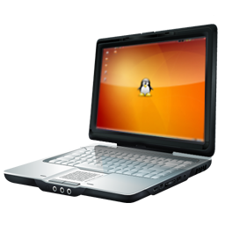


Setup for Exercises
Follow ‘DSF Workshop – Setup Instructions’ to install Eclipse and import project.
Day One:
Project: com.kichwacoders.cdt.dsf.tutorial
First Package: com.kichwacoders.cdt.dsf.tutorial.helloworld
Get your fingers
ready to type:
Look out for this symbol. It appears on all slides with hands-on exercises.

Slide 15
Exercise 0
Run Ex0_HelloWorld.java
Modify to use RequestMonitor (callback object)
See TODOs
Create Executor to pass to RequestMonitor
Create RequestMonitor object with handler method
Add RequestMonitor parameter to long running method
Solution:
com.kichwacoders.cdt.dsf.tutorial.helloworld. solution.Ex0_HelloWorld

Slide 16
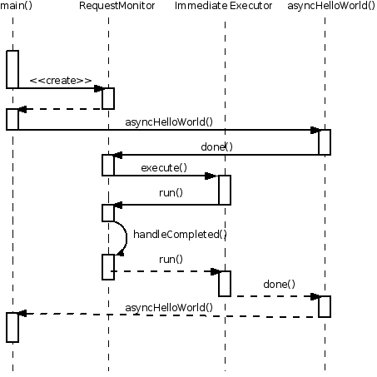
Sequence of Async HelloWorld
http://help.eclipse.org/luna/topic/org.eclipse.cdt.doc.isv/guide/dsf/intro/dsf_programming_intro.html

Slide 17
DSF Synchronization: Executors
DSF uses a single-threaded executor
The DSF data model can only be accessed by the main DSF executor
Easier than multi-threaded as there are no race conditions or deadlocks
Accessing data from different threads requires synchronization
SWT thread
Notes:
Accessing data from different threads requires synchronization
DSF uses a single-threaded executor to avoid synchronization

Slide 18
Request Monitor
Executor
Immediate Executor
DSF Executor
Status
Error
Cancel
Warning
Success

Slide 19
Exercise 1: Handle Failure
1. Run Ex1_HelloWorld.java
2. Modify program to handle a failure and pretend hello world fails:
Replace handleCompleted() with handleSuccess()
Add methods to handle failure & display status
Create Status Error object (see hints in code)
Set status of Request Monitor to error object
Solution is com.kichwacoders.cdt.dsf.tutorial.helloworld. solution.Ex1_HelloWorld

Slide 20
Data Request Monitor
For when you need to return a value to the caller.
Uses generics for compile time type checking.
public class DataRequestMonitor<V> extends RequestMonitor {
public synchronized void setData(V data)
{ fData = data; }
public synchronized V getData()
{ return fData; }

Slide 21
Exercise 2: Data Request Monitor
1. Run Ex2_HelloWorld.java
2. Modify program to use a DataRequestMonitor to return the value of the makeHelloMessage method
Use the getData and setData methods
Don’t forget to create an executor this time
Solution is com.kichwacoders.cdt.dsf.tutorial.helloworld. solution.Ex2_HelloWorld

Slide 22
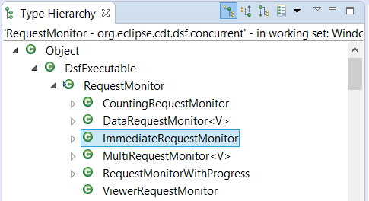
Other Request Monitors
CountingRequestMonitor
MultiRequestMonitor
For multiple asynchronous request in parallel
ImmediateRequestMonitor
Request Monitor +
Immediate Executor
(for Convenience)
(Use ‘F4’ on RequestMonitor type)

Slide 23
Exercise 3: Nesting & Combining
Ex3a_HelloWorld.java has 2 nested request monitors
Try to run this program, why does it fail?
See if you can fix it by properly calling rm.done()
Ex3b_HelloWorld.java combines output from different async methods
Try to run this program, what is the output?
See if you can fix it so it uses the output of the methods to say ‘Hello, World x 10’
Solutions are:
com.kichwacoders.cdt.dsf.tutorial.helloworld.solution.Ex3a_HelloWorld
com.kichwacoders.cdt.dsf.tutorial.helloworld.solution.Ex3b_HelloWorld

Slide 24

Review (1): Async Methods Overview
Asynchronous methods make DSF efficient
DSF uses a single-threaded executor
RequestMonitor is used for callbacks in DSF

Slide 25
Review (2): Request Monitor Overview
Request monitor has callbacks to handle completion, success, failure, etc
Use Status objects to indicate if things go wrong
Different kinds of monitors
Data Request Monitor for passing back data
Monitors can be nested and combined
Be careful to always call rm.done()

Slide 26
DAY ONE: 2. DSF OVERVIEW
Debugger Services Framework Tutorial, Kichwa Coders

Slide 27

DSF Overview
Framework for integrating debuggers in Eclipse
Replaced CDI around 2008
Designed for efficiency
slow or remote targets
Flexible hierarchy for views
Very powerful but complex

Slide 28
DAY ONE: 2. VIEW MODEL
Debugger Services Framework Tutorial, Kichwa Coders

Slide 29
View Model
View Model provides layer of abstraction for views
User-presentable structure of the data
View Model allows one to easily modify presentation e.g.
Hide running threads
Limit number of stack frames
Only show processes if there is more than one

Slide 30
Flexible Hierarchy - Overview
1. VMAdapter
2. VMProvider
3. VMNode
4. VMContext

Slide 31
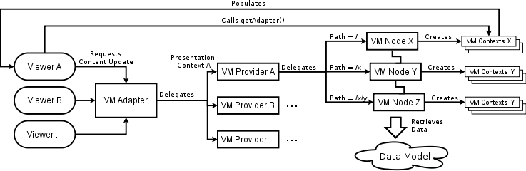
View Model – Flexible Hierarchy
http://help.eclipse.org/luna/topic/org.eclipse.cdt.doc.isv/guide/dsf/intro/dsf_programming_intro.html

Slide 32
VMAdapter
The adapter is the top-level object in the view model hierarchy. All the content updates from the viewers are handled by a single instance of the VM Adapter. The VM Adapter then delegates the handling of these updates to the appropriate VM Provider based on the presentation context contained in the update object.
http://help.eclipse.org/luna/topic/org.eclipse.cdt.doc.isv/guide/dsf/intro/dsf_programming_intro.html

Slide 33
VMProviders
The provider manages the content for a single view. It delegates content requests to the appropriate VM Node, based on the tree path of element in the update object.
http://help.eclipse.org/luna/topic/org.eclipse.cdt.doc.isv/guide/dsf/intro/dsf_programming_intro.html

Slide 34
VMNodes
The VM Nodes allows for grouping of like-elements in the view. Examples of such nodes are: threads node, stack frames node, variables node, etc. The VM Node creates VM Context objects to represents elements of data in the Data Model.
http://help.eclipse.org/luna/topic/org.eclipse.cdt.doc.isv/guide/dsf/intro/dsf_programming_intro.html

Slide 35
VMContexts
The VM Context objects are used to populate the content of the viewer. A given VM Context may contain a reference to an element in the Data Model (e.g. a stack frame or a variable), or it may be used purely for presentation purposes (e.g. the "Add new expression" entry in Expressions view).
http://help.eclipse.org/luna/topic/org.eclipse.cdt.doc.isv/guide/dsf/intro/dsf_programming_intro.html

Slide 36
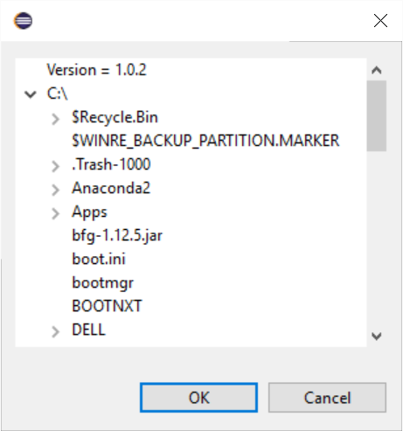
View Model – File Browser Exercise
In this exercise, we build a simple file browser using the DSF view model.
Simplified example that does not have a DSF data model (uses file system)
Solution:
com.kichwacoders.cdt.dsf.tutorial.viewmodel.solution

Slide 37
View Model – File Browser Exercise
VIEWER
TreeModelViewer
(FileBrowserDialog)
VMADAPTER
FileBrowserModelAdapter
VMPROVIDER
FileBrowserVMProvider
VMNode
FileVMNode
VMContext
FileVMContext
VMNode
VersionVMNode
VMNode
VersionVMContext

Slide 38
View Model – File Browser Exercise
File Browser Exercise
Project: com.kichwacoders.cdt.dsf.tutorial
Package: com.kichwacoders.cdt.dsf.tutorial.viewmodel
Work through TODOs in this package (5 in total)
To test, Run As Eclipse Application, click on new button in toolbar
Solution can be found in package com.kichwacoders.cdt.dsf.tutorial.viewmodel.solution
This exercise is a modified version of the DSF Tutorial File Browser with the addition of a Version node. For the original implementation which includes events and background jobs, please see:
Project: org.eclipse.cdt.examples.dsf
Package: org.eclipse.cdt.examples.dsf.filebrowser

Slide 39
View Model – Advanced Topics
Layout Customization – controlled by configuration of VMNodes in a VMProvider.
Event Handling
VMProvider receives events from data model
Build deltas are used to build up changes
Deltas are sent to viewer so it can refresh itself
Property Providers/Label Providers
Extension interfaces to control labels

Slide 40
Review: View Model Overview
One VMAdapter
One VMProvider per view
Multiple VMNodes and VMContexts for display
Lots of functionality to support flexibility

Slide 41
DAY ONE: 2. DATA MODEL
Debugger Services Framework Tutorial, Kichwa Coders

Slide 42
DSF Concepts
Services
Sessions
Trackers
Events
Data Model Contexts

Slide 43
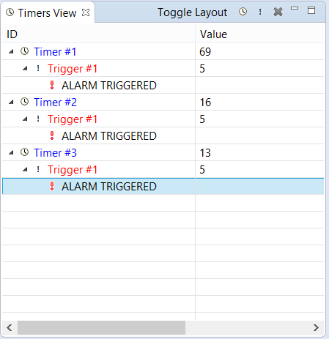
Timers Example
Get timers example up and running.
Project: com.kichwacoders.cdt.dsf.tutorial
Package: com.kichwacoders.cdt.dsf.tutorial.timers
Launch As Eclipse application
Run As > Eclipse Application
Show View > DSF Tutorial > Timers
Example Timers
Based on
Project: org.eclipse.cdt.examples.dsf
Package: org.eclipse.cdt.examples.dsf.timers

Slide 44
DSF Services
Entities managing logical subsets of the data model
Based on OSGi services
Implement IDSFServices or extend AbstractDSFService

Slide 45
DSF Services – Timers Example
Timer Service
startTimer()
Alarm Service
createTrigger()
deleteTrigger()
killTimer()
getTimers()
getTimerValue()
setTriggerValue()
getAlarm()

Slide 46
DSF Session
Manages groups of services
There can be multiple sessions running at the same time
The session provides the DSF Executor ( DsfSession#getExecutor() )
A session handles sending events to registered listeners

Slide 47
DSF Session – Timers Example
Start Session
Services reference session
End Session
fSession = DsfSession.startSession( fExecutor, "Timers(DSF Example)");
fTimerService = new TimerService(fSession);
fAlarmService = new AlarmService(fSession);
DsfSession.endSession(fSession);

Slide 48
DSF Session Quiz
How do you access the running DSF sessions?
(Hint: use the DsfSession class)
Get a specific session:
DsfSession session = DsfSession.getSession(sessionId);
Get all the sessions:
DsfSession[] sessions = DsfSession.getActiveSessions();

Slide 49
DSF Trackers
Utility class to help access services
org.eclipse.cdt.dsf.service.DsfServicesTracker
Example Usage:
DsfServicesTracker tracker = new DsfServicesTracker(Activator.getBundleContext(), session.getId());
final TimerService timerService = tracker.getService(TimerService.class);
tracker.dispose(); //must dispose or could have a service reference leak

Slide 50
Data Model
Data Model is the natural structure of objects being retrieved by DSF services
Data model is divided into groups to achieve maximum performance and usability, for example, groups could be:
Registers data model
Memory data model
Independent of presentation to user
Provides building blocks for the view model

Slide 51
Data Model Contexts
IDMContext class is a handle to any group of data in the data model
IExecutionDMContext for thread, process, group
IFrameDMContext for stack frames
IRegisterDMContext for registers
IBreakpointDMContext for breakpoint, tracepoint, etc
All contexts extend IDMContext (use F4 for a full list)
Contexts are used to retrieve data from services
Contexts are hierachical
process -> thread -> frame -> expression
DMContexts.getAncestorOfType()
Context Objects are thread safe and light-weight. Preferably they should be immutable.

Slide 52
Data Model Contexts - Timers
How many DM contexts are there in the timers example?
Which contexts has parents contexts?
How can you get the parent context for a specific context?
For full answers and explanations, please see http://help.eclipse.org/luna/topic/org.eclipse.cdt.doc.isv/guide/dsf/intro/dsf_programming_intro.html

Slide 53
Events
Events are how the Data Model tells the View Model of changes
for example if a breakpoint is hit, update the debug view with the relevant information
Events also notify services of other services' changes
for example clearing caches when execution resumes

Slide 54
DSF Events details
Most events implement IDMEvent which provides an IDMContext
e.g., When thread suspends, event specifies which thread
Event types usually found in the different service interfaces e.g.,
IRunControl :
ISuspendedDMEvent , IContainerSuspendedDMEvent
IResumedDMEvent , IContainerResumedDMEvent
Not all services trigger events
IStack has no events

Slide 55
DSF Events - Timers
What events are used in the Timers view?
How are events dispatched?
How are events received?
For full answers and explanations, please see http://help.eclipse.org/luna/topic/org.eclipse.cdt.doc.isv/guide/dsf/intro/dsf_programming_intro.html

Slide 56
VMAdapter Glue
Base class: AbstractVMAdapter
Adapter mechanism is like the glue of Eclipse APIs. It allows objects to be associated together without having any explicit dependencies between each other.
It is useful to know the ‘formula’ for connecting the adapter

Slide 57
Adapter Glue - Timers
What is the adapter ‘glue’ for the timers example?
From TimersView.java
// Create the flexible hierarchy content/label adapter. Then
// register it with the session.
fTimersVMAdapter = new TimersVMAdapter(fSession, fPresentationContext);
fSession.registerModelAdapter(IElementContentProvider.class, fTimersVMAdapter);
fSession.registerModelAdapter(IModelProxyFactory.class, fTimersVMAdapter);
fSession.registerModelAdapter(IColumnPresentationFactory.class, fTimersVMAdapter);

Slide 58
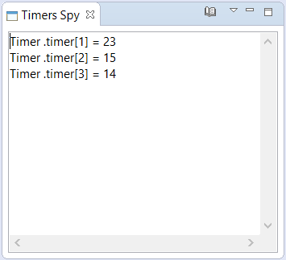
Data Model – Timers Spy View Exercise
In this exercise, modify the SpyTimersView class to access the Timers DSF data model.
Have it display available timers & their value
To see view, do Run As > Eclipse Application
Show View > DSF Tutorial > Timers Spy
Solution:
com.kichwacoders.cdt.dsf.tutorial.timers.solution

Slide 59
Hint for Timer Spy Example: after you have the service
session.getExecutor().execute(new Runnable() {
@Override
public void run() {
// TODO: get data from the service
// Update the viewer, with fLogText
// Needs to be in an asyncExec
// e.g. Display.getDefault().asyncExec...
}

Slide 60
Review: Data Model Overview
Data model represents back-end
Services give API access to data model
Services are grouped and managed by sessions
DM Contexts are hierarchical handles to sections of the data model

Slide 61
DAY TWO: DSF & GDB
Debugger Services Framework Tutorial, Kichwa Coders

Slide 62
DAY TWO: 1. DSF Data model
Debugger Services Framework Tutorial, Kichwa Coders

Slide 63
Data Model Review
Session, Tracker, Executor
Services
IDMContext
IDMData

Slide 64
DSF GDB Session & Executor
Both are managed as part of the Launch Object
Default DSF Executor created
DSF Session gets created
Launch object also handles disposing of it

Slide 65
DSF GDB Executor
What line in GDBLaunch creates the Executor?
What line in GDBLaunch creates the Session?
final DefaultDsfExecutor dsfExecutor = new DefaultDsfExecutor(GdbLaunchDelegate.GDB_DEBUG_MODEL_ID);
fSession = DsfSession.startSession(fExecutor, GdbLaunchDelegate.GDB_DEBUG_MODEL_ID);

Slide 66
Getting GDB DSF Session
For GDB-DSF we can get the DSF Session from any active debug context
IAdaptable context = DebugUITools.getDebugContext();
IDMContext dmc = (IDMContext)context.getAdapter(IDMContext.class);
DsfSession session = DsfSession.getSession(dmc.getSessionId());

Slide 67
DSF GDB Services
Breakpoint Manager Service
Disassembly
Breakpoints Synchronizer
Back End GDB
Command Control
Setup environment, launches gdb
Gets I/O streams and creates Rx & Tx Threads (for MI and CLI)
Run Control
Start, stop, suspend, resume and events for managing these
GDB Processes
Manages inferior processes, threads, containers
Memory
Breakpoints
Registers
Get memory, set memory, fill memory
Insert, remove, get and update breakpoints
Listeners for breakpoints added, removed, changed
Manages registers, register groups and bit fields
Get disassembly blocks for frames and addresses
Ensures Eclipse knows about breakpoints set directly in gdb
Stack
Manages stack frames, arguments and local variables
Not all services are shown.
See org.eclipse.cdt.dsf.gdb.launching.ServicesLaunchSequence for full list.

Slide 68
Versions of DSF GBD Services
Different versions of GDB have different versions of DSF-GDB Services org.eclipse.cdt.dsf.gdb.service.GdbDebugServicesFactory
protected IBreakpoints createBreakpointService(DsfSession session) {
if (GDB_7_7_VERSION.compareTo(fVersion) <= 0) {
return new GDBBreakpoints_7_7(session);
}
if (GDB_7_6_VERSION.compareTo(fVersion) <= 0) {
return new GDBBreakpoints_7_6(session);
}
if (GDB_7_4_VERSION.compareTo(fVersion) <= 0) {
return new GDBBreakpoints_7_4(session);
}
if (GDB_7_2_VERSION.compareTo(fVersion) <= 0 || "6.8.50.20090414".equals(fVersion)) {
return new GDBBreakpoints_7_2(session);
}
if (GDB_7_0_VERSION.compareTo(fVersion) <= 0) {
return new GDBBreakpoints_7_0(session);
}
return new MIBreakpoints(session);
}

Slide 69
Exercise DSF1
FrameSpy to periodically print "method:line" for current frame
See com.kichwacoders.cdt.dsf.gdb.tutorial.framespy .polling.FrameSpyPollingView
To test, make sure you launch a C/C++ Debug session first
To see view, do Run As> Eclipse Application
Show View > DSF Tutorial > DSF-GDB Frame Spy with Polling
Use the Tasks view to see what needs to be done
Solution:
com.kichwacoders.cdt.dsf.gdb.tutorial.framespy.polling.solution

Slide 70
Exercise DSF1: Review
What if you select the process element? The top frame of which thread should we use?
For now, just handle the error (as seen on console)
Override handleError()
Solution:
com.kichwacoders.cdt.dsf.gdb.tutorial.framespy.polling.solution

Slide 71
Assertions
Assertions are a great way to notice unexpected situations
Enable assertions in development eclipse for test eclipse
In launch configuration, Arguments tab, VM arguments
Add -ea
Make sure you have a breakpoint for AssertionError
Re-launch and try

Slide 72
DAY TWO: 2. Extending GDB & Adding commands
Debugger Services Framework Tutorial, Kichwa Coders

Slide 73
Extending GDB-DSF
In DSF-GDB everything “hangs-off” a Launch which has the DsfSession
Need a new or extended Service to provide new functionality
Service should extend an existing service or AbstractDsfService

Slide 74
5 Steps To Connect A New Service First Time
1. GDBLaunch
Create a subclass
Gives a unique class for instanceof checks, required for adapters to work
2. ServicesLaunchSequence
Create a subclass
Override getSteps to launch the new service
3. GdbDebugServicesFactory
Create a subclass
To extend existing service, override its createXYZService method
4. GDBLaunchDelegate
Override createGdbLaunch to return launch written in Step 1
Override getServicesSequence to return sequence written in Step 2
Override newServiceFactory to return factory written in Step 3
5. org.eclipse.debug.core.
launchDelegate
Set the type to org.eclipse.cdt.launch.applicationLaunchType
Set the delegate to launch delegate written in Step 4
To create a new service, override createService

Slide 75
5 Steps To Connect A New Service Second and subsequent times
1. ServicesLaunchSequence
Subclass
Edit getSteps to launch the new service
2. GdbDebugServicesFactory Subclass
To extend existing service, override its createXYZService method
To create a new service, override createService

Slide 76
Adding a New Command
Everything in DSF is generic and replaceable
This includes commands
Fundamental theorem of software engineering
"We can solve any problem by introducing an extra level of indirection."
“…except for the problem of too many levels of indirection.”

Slide 77
Adding a New Command (part 1)
1. Define command using org.eclipse.ui.commands extension point
No operation/code – no UI visible
2. Display a command in menu or toolbar using org.eclipse.ui.menus extension point
Just UI and enablements of the UI – still no code
Just a name
org.eclipse.cdt.examples.dsf.gdb.command.showVersion
toolbar:org.eclipse.debug.ui.DebugView?before=stepGroup
3. Command handler using org.eclipse.ui.handlers extension point
Connect UI/Command to code
Different handlers can be enabled under different conditions

Slide 78
Adding a New Command (part 2)
4. Command handlers in Debug are abstracted again with DebugCommandHandler
Connects Command Handler to an interface using getCommandType()
See ShowVersionHandler
So actually no (real) code after all, but indirection
5. Adapter Factory instantiates real class for specified interface
See GdbExtendedAdapterFactory for connection
See DsfShowVersionHandler for actual command handler
6. Actual code in Java
See DsfShowVersionHandler for actual command handler

Slide 79
Setup for Exercises
Follow ‘DSF Workshop – Setup Instructions’ to install Eclipse and import project.
Day Two – DSF-GDB:
Project: org.eclipse.cdt.examples.dsf.gdb
Get your fingers
ready to type:
Look out for this symbol. It appears on all slides with hands-on exercises.

Slide 80
Command Exercise: 1. Implement an IDebugCommandHandler
Implement DsfShowVersionHandler.getContext
extract ICommandControlDMContext from request, if available
Hint: use DMContexts helper methods
Hint: The IDebugCommandRequest has the selected elements
Implement DsfShowVersionHandler.canExecute and execute
use IGDBExtendedFunctions service to get the version
Hint: there is already a DSF Tracker field
Solution:
com.kichwacoders.cdt.dsf.gdb.tutorial.framespy.events.solution

Slide 81
Command Exercise: 2. Get the Version from GDB
Create new Show Version command
Create a new class
Needs to extend MIInterpreterExecConsole<MIGDBVersionInfo>
The CLI command that will be used is “show version”
Add createCLIGDBVersion to GdbExtendedCommandFactory_6_8
This should instantiate our new command
In GDBExtendedService:
Get the IMICommandControl
Hint: IMICommandControl is a service
Create GDB command with IMICommandControl.getCommandFactory
Hint: You can use instanceof GdbExtendedCommandFactory_6_8
Run GDB command with IMICommandControl.queueCommand
Solution:
com.kichwacoders.cdt.dsf.gdb.tutorial.framespy.events.solution

Slide 82
Command Exercise: 3. Use A Command Cache
private CommandCache fVersionCache;
In the doInitialize:
fVersionCache = new CommandCache(getSession(), fCommandControl);
fVersionCache.setContextAvailable(fCommandControl.getContext(), true);
In the Get Version:
fVersionCache.execute instead of fCommandControl.queueCommand
Solution:
com.kichwacoders.cdt.dsf.gdb.tutorial.framespy.events.solution

Slide 83
Command Exercise: 4. Clear Command Cache
Add Service Event Listener in doInitialize
getSession().addServiceEventListener(this, null);
Remove Service Event Listener in shutdown
getSession().removeServiceEventListener(this);
Clear the cache on Suspended Events
@DsfServiceEventHandler
public void eventDispatched(ISuspendedDMEvent e) {
fVersionCache.reset();
}
Solution:
com.kichwacoders.cdt.dsf.gdb.tutorial.framespy.events.solution

Slide 84
Contexts – Review
There are two types of Contexts
IDMContext →
Handles to “things” in the data model
Defined by and created by IDsfService(s)
IVMContext →
Handles to “things” in the view mode
Defined by and created by IVMNode(s)
All contexts are hierarchical, with zero or more parents at every level

Slide 85
Contexts – IDMVMContext
Special View Model context that is a handle to both a UI “thing” and a data model “thing”
IDMVMContext is extension of IVMContext
This means it is directly a handle to the UI “thing”
IDMVMContext.getDMContext() : IDMContext
This method returns the connect to data model “thing”

Slide 86
Data Model Contexts – GDB-DSF
ICommandControlDMContext → root of all DSF-GDB contexts
IProcessDMContext → process
IContainerDMContext → group of threads
IExecutionDMContext → thread
IFrameDMContext → stack frame
IVariableDMContext → variable
IRegisterGroupDMContext → register group
IRegisterDMContext → register
IBitFieldDMContext → individual bitfield of register

Slide 87
Data Model Contexts – GDB-DSF (2)
By default many contexts are equivalent with different names
In some implementations you may have different hierarchy and different association
For example, IBreakpointsTargetDMContext → what breakpoints can be installed on
for GDB < 7.4 is the same as IContainerDMContext
for GDB >= 7.4 is the same as ICommandControlDMContext
Other context equivalents of ICommandControlDMContext:
ISymbolDMContext → debug symbols scope
ISourceLookupDMContext → source lookup scope
ISignalsDMContext → signal target
Other context equivalents of IContainerDMContext:
IDisassemblyDMContext → disassembly
IMemoryDMContext → memory

Slide 88
DAY TWO: 3. view model
Debugger Services Framework Tutorial, Kichwa Coders

Slide 89
DSF GDB VM Providers
LaunchVMProvider
Debug View
Variables View
Registers View
Expressions View
Modules View
Breakpoints View
GdbVariableVMProvider
RegisterVMProvider
GdbExpressionVMProvider
ModulesVMProvider
GdbBreakpointVMProvider
See org.eclipse.cdt.dsf.gdb.internal.ui.viewmode.GdbViewModelAdapterfor full list.

Slide 90
5 Steps To Override a DSF-GDB View
Create a subclass to override
2. VMProvider
Create a subclass to override
GdbExtendedLaunchVMProvider
3.VMNode
Create a subclass to override
ThreadVMNode
4. GdbExtendedVMMessages
Add in new class and properties file
GdbExtendedViewModelAdapter
1. GdbViewModelAdapter
5.GDBAdapterFactory
Copy and add in our GdbExtendedViewModelAdapter
See org.eclipse.cdt.examples.dsf.gdb.viewmodel for a concrete example list.

Slide 91
Review: DSF-GDB Overview
Access any part of the DSF-GDB data model through the DSF session
Access any part of the DSF-GDB view providers through the GDBViewModelAdapter
Follow the formula to add in a new service or override a service
Connect up command handlers for user actions in buttons
DON’T FORGET TO CALL rm.done()

Slide 92

Congratulations!
You are now DSF developers!
(In addition to being CDT developers)

Slide 93
Resources
Examples and Exercises
https://github.com/jonahkichwacoders/cdt-examples
CDT Help
DSF Tutorial: Timers example, FileBrowser
http://help.eclipse.org/luna/topic/org.eclipse.cdt.doc.isv/guide/dsf/intro/dsf_programming_intro.html
DSF-GDB Exercises
https://github.com/jonahkichwacoders/EclipseTraining
Slides to be emailed

Slide 94
Support
3 months, direct email support
Please email: jonah@kichwacoders.com or tracy@kichwacoders.com
In person at EclipseCon France, Toulouse June 7th-9th
Any time: cdt-dev mailing list
https://dev.eclipse.org/mailman/listinfo/cdt-dev
You are now DSF developers, so that makes you CDT developers!
Register for mailing list and ask questions
We or the community can help you there

Slide 95
rm.done();

